Slide 1
PITCH DECK PRESENTATION
PRESENTER :
MARY ABIA EDIETE
1

Slide 2
PRESENTATION
HIGHLIGHTS
Overview of the Business
Key Stakeholders Key strategic partners or alliances
SWOT Analysis Goals for Shifting the Strategy Key Performance Indicators Financial Projections
Overview of Corporate Social Responsibility
Risks and mitigation strategy Recommendations from implementation

Slide 3
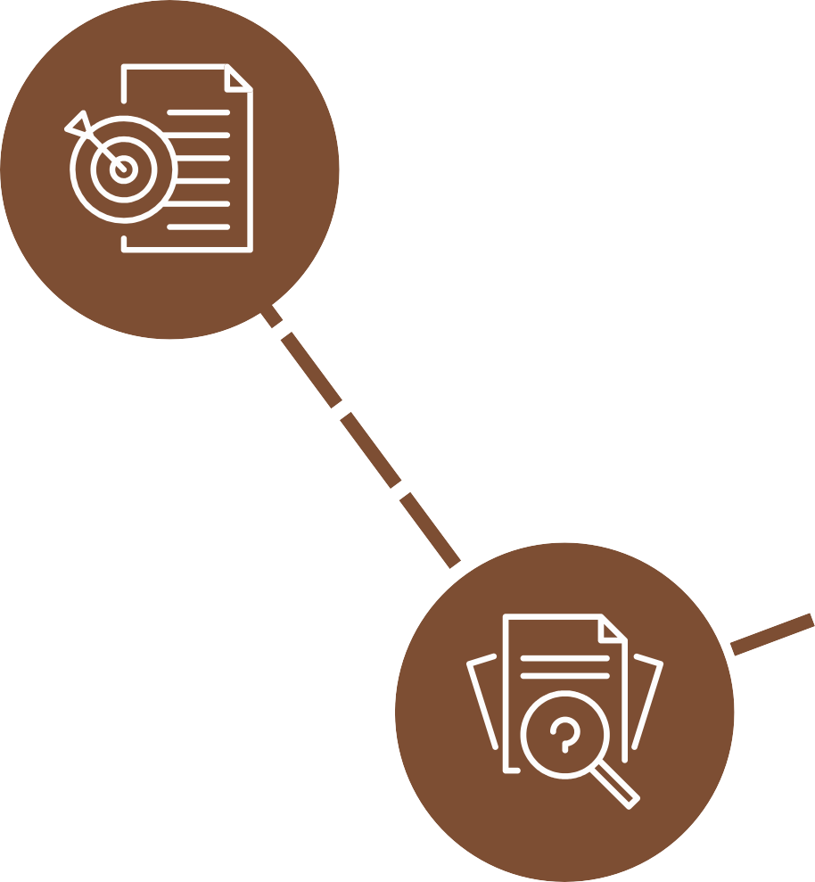




OVERVIEW OF THE BUSINESS
About the Business
Jumia is a one-stop online store that delivers a broad range of goods to your door, including but
not limited to electronics, furniture, home appliances, and much more
Reason for Change
Customers have recently voiced complaints and expressed dissatisfaction with the delay in order processing and delivery.
The Desired Change
Jumia's current business model calls for business process automation in order to enhance the business process.
Current Business Process
Jumia is now operating a manual business procedure, which was advantageous to the company in the past but is today leading to consumer unhappiness and a loss of market share.
Notes:
ABOUT THE BUSINESS (Ediete, 2022)
Jumia is a one-stop online store that delivers a broad range of goods to your door, including but not limited to electronics, furniture, home appliances, and much more. It strives to be the largest, most reputable, and most customer-focused company.
Mission Statement (Jumia, n.d.):
The company’s mission statement is “We believe that technology has the potential to transform everyday life in Africa, for the better. We built Jumia to help consumers access millions of goods and services conveniently and at the best prices while opening up a new way for sellers to reach consumers and grow their businesses.”
Vision Statement
The company’s vision statement is “To become the one-stop shop for retail worldwide with implementation of best practices both online and offline.”
Goal & Objective:
To be the most professional e-commerce site in the countries it operates in.
To be the preferred reference for all items relating to fashion, technology, and appliances.
Increase the awareness and trust in e-commerce
Competitive Analysis:
Most customers receive their orders within three to six days of submitting them.
Mobile friendly site
Fashion blog
CURRENT BUSINESS PROCESS
The current business process operations in Jumia are:
Customers use the platform to place their orders from across Nigeria.
Depending on the product's availability, its location, and the delivery location, order processing and delivery can take 3–14 days.
After placing an order, customers have between 24 and 48 hours to return or exchange items.
Jumia is currently seeing a decline in its sales performance.
THE DESIRED CHANGE
In order to improve the business process, Jumia's existing business model calls for business process automation. Automating time-consuming chores like price comparison and inventory management for this kind of business may first be difficult and scary. Automation may, however, quickly earn back its cost. Jumia will automate the order delivery process in one way using the selling partner API. To increase automation, a platform with multiple merchants will offer an application programming interface. The Selling Partner API will enable merchants and Jumia staff members to connect automated systems to coordinate processes and sync data.
For example, if during the process where employees park the order, the system is immediately notified so the logistics department is aware of the order awaiting pickup, and the process continues until it reaches its final destination as seen in the proposed plan, this can help reduce the time spent from order parking to shipping and reduce the wait time from 3 to 7 days as it was to at most 1-2 days, as well as notify the merchants to update inventory. An additional process that needs automation is the verification of consumer orders.
Customers verbally confirm the details of their orders, such as the order coupon code, as can be seen in the present business model. Automation, however, may proactively protect customers against fraud by recording things in Transparency. This serialization method allows the fulfilment team members to track things using particular automated codes to verify authenticity. Customers may see more product details and make sure they are receiving the right things by scanning the Transparency code.
Additionally, internet businesses overestimate delivery timeframes 53% of the time. Due to shipping automation, they won't need to manually estimate transit times. Shipping Setting Automation (SSA) offers accurate delivery estimates based on the location of the warehouse, the customer, and the delivery services. When an employee adds an ASIN into the shipping template, delivery timeframes are automatically adjusted so that you and the client may track the package's progress. Jumia will put this into effect to reduce the wait time for deliveries and provide alternatives for same-day or next-day delivery depending on the location.
Jumia, like Amazon, will utilize a series of computerized floor labels with barcodes to navigate its warehouse, combined with automatic truck guidance and RFID. This will make it easier for personnel to find items/products on shelves and reduce search times from hours, sometimes even days, to minutes. It simplifies the process and cuts down on customer wait times. Staff can now complete thousands of orders rather than just a few hundred.
Order fulfilment at the warehouses is now progressing slowly, as was previously mentioned. Pickers and stockers are Jumia employees' jobs in the fulfilment centers. Stockers at the current Jumia facilities move carts full of products up and down long aisles, placing them randomly on shelves where there was room, and scanning them using a portable device to determine their position in a system. Every day, pickers at fulfilment centers travel a great distance while removing things from shelves, scanning them, and placing them into carts they pushed. increasing the difficulty of order fulfilment and the time it takes to finish orders.
As a result, tasks that would often need more time, effort, and the possibility of human mistake may be simply automated. The goal of this solution is to automate order processing so that Jumia's warehouse can fulfill orders more quickly and easily. The stockers' job is to receive things and place them on the open shelves of the shelving units, therefore the robots' mission is to move empty shelving units, or "pods," to their workstations. When the pod is full, the stocker presses a button to send the robot and related shelving unit across an enclosed warehouse space, arriving at the "picker's" workstation in the process.
These robots will assist in inventory management in addition to making it easier for order fulfilment staff to locate the items on their stocking shelves. This robot army will help the company honor its growing commitment to customers about quick deliveries.
It promises speedier delivery by integrating this unique product into the warehouses, something the competitors now lack. The robots will raise the average picker's production from roughly 100 things per hour to a target of about 300 items per hour, however specific numbers may vary.
The goal is to live up to competitors' expectations, including those of Amazon, who now deploys robots in its warehouse. When it comes to order fulfillment, Jumia will surpass regional competition in the area where it operates, boosting its market share

Slide 4

KEY STAKEHOLDERS
Employees impacted by the change External customers
Third-party manufacturing company Project manager
Credit facility Board members Shareholders
Third-party research and development centre
Internal customers

Slide 5






KEY STRATEGIC PARTNERS
Credit Facility
The management of Jumia is only one of the important strategic partners needed to carry out this operation. To guarantee the success of this initiative, more partners are required.
Jumia will get bank financing with a ten- year payback schedule in order to finance this robotics project.
Youibot
Jumia will collaborate with Youibot to construct the AVGs robots required for this business process automation. Youibot is a top autonomous mobile robot manufacturer in China with core algorithms for mobile robots and a solid robot system.
Employees
Because they will ensure that the suggested change in a business process from manual to automated will be implemented in order to assist the firm to accomplish its goals, workers are regarded as strategic essential partners.
Other 3rd Party Partners
They include other manufacturers and developers that will produce the RFID tags, and automate the delivery process.

Slide 6

Strengths
S
High product quality Geographical presence Diverse product offering
Enhance strengths by:
Keep up the quality of goods Leverage geographical advantage Invest in predictive analysis
Weakness
Inability to comprehend client wants and expectations Lack of funding for marketing and promotion operations
Sluggish order processing and long delivery time
W
Remediate weakness by:
Invest in big data analytics
Improve marketing and promotional expenditure
Invest in Automated Vehicle Guides (AVGs) and RFID Tags
Notes:
Strengths:
High product quality boosts customer loyalty to the company and enhances Jumia Nigeria's performance in its competitive industry.
One of Jumia's key competitive advantages is its geographical presence in several locations. It makes sure that customers can easily access the company and helps it reach its target market.
Due to the organization's diverse product offering, it may be possible to increase the client base and balance off losses from one product category with gains from another (Byrne, 2018).
Enhance Strengths by (at least 3):
Jumia needs to keep up the quality of its goods if it wants to increase consumer loyalty and strengthen its position in the market.
Jumia could leverage its geographic advantages to its advantage by entering new countries and areas in order to increase its market reach and capture greater market share.
Jumia should invest in its predictive analytics so that it can make product recommendations to consumers based on data collected from customers to increase sales and better understand which items are performing better and the quantity to stock over the other products not performing better.
Weakness
Inability to comprehend client wants and expectations results in inadequate strategic decision-making, such as choosing which merchandise to store more of and in what location. Due to this limitation, the organization might be unable to pinpoint possible areas for product/service mix enhancement (Byrne, 2018).
The capacity of the business to grow its client base and promote repeat business is weakened by a lack of funding for marketing and promotion operations (Byrne, 2018).
Due to ineffective inventory management techniques, sluggish order processing, and longer delivery times than its rivals, the business may experience efficiency losses. Lack of sales or high inventory levels may lead to decreased sales or no sales of a certain product, which might eventually cause the company to go out of business.
Remediate Weaknesses by:
Jumia must make investments in its Big Data Analytics in order to be able to make strategic decisions, such as using predictive analytics to understand which products to stock more of in their warehouses and in which warehouse based on the customer's purchasing location in order to increase item sales and net income while reducing delivery times and overall costs.
Jumia will need to improve its marketing and promotional expenditure in order to reach more people and gain market share in order to address the weak market reach.
Jumia will need to invest in Automated Vehicle Guides (AVGs), RFID tags to aid with inventory management, and speed up the order processing and fulfilment process to help reduce the time spent on processing orders, which will help cut the time spent on processing orders and help improve sales. Jumia will also invest in big data analytics to help obtain, preserve, and analyze data effectively so that the company can utilize it to make business-related choices

Slide 7
Opportunities
0
Launch more high-end items
Use the creation of new technologies Business and product line development
Exploit opportunities by:
Develop innovative goods and services Invest in research and development Target a globally scattered customer base
Threats
Globalization challenges Changing government regulations Inflation
Minimize threats by:
Understand cultural diversity Strong supply chain network Raise its spending on research and development
Concentrate on pricing strategy
T
Notes:
Opportunities
An opportunity to launch more high-end items may be seen in the rise in consumer disposable income and its increased market reach.
It is possible to use the creation of new technologies to aid in the production and distribution of goods and services to integrate innovation into business processes. Integration of cutting-edge technology may save costs, boost productivity, and hasten the release of new goods (Byrne, 2018).
Opportunities for business and product line development are presented by emerging market segments and niches.
Exploit opportunities by:
Jumia will exploit its customers' potential enhanced spending power to develop innovative goods and services that it would then propose to its consumers in order to boost sales.
To take advantage of the opportunities that come with emerging technologies, Jumia will invest in their research and development. Jumia will need to spend money on RFID tags and Automated Vehicle Guides (AVGs) to help with the distribution of products and services in order to increase productivity.
The firm will be able to target a globally scattered consumer base, extend its product range, and boost profitability by expanding into new areas.
Threats
Globalization pushes the business to expand into new markets, as such it may be challenging for Jumia, Nigeria to enter a new market like the U.S. where there are already dominant companies since those businesses already command a significant share of the market. The amount of competition in a market that is already saturated is strong, which makes it difficult for newcomers to get a foothold in the industry
The changing government regulations of Nigeria affected a change of Jumia Nigeria from Retail to Marketplace B and is still seriously threatened by the evolving regulatory landscape and the implementation of new, harsher restrictions. It complicates and makes it harder for the corporate organization to comply with the law. The likelihood of costly legal actions increases when regulations are not followed (Byrne, 2018).
The profitability of the company is impacted by the growth in production costs due to inflation (Byrne, 2018).
Minimize Threats by:
Jumia will need to conduct extensive research, comprehend the cultural diversity of its intended new market, raise enormous capital for high advertising expenses, and make sure they have a strong supply chain network in order to be able to stand out in their new market in order to combat the threat of new entrants.
Jumia will raise its spending on R&D operations to address the problems caused by its many rivals, such as establishing new warehouses to fulfill more orders quickly and effectively to handle the strain of the market. They may also use fresh advertising strategies to let their target market know about their goods and services.
Jumia should concentrate on their pricing strategy in order to increase profitability and overcome challenges brought on by the current economic climate.

Slide 8
GOALS FOR SHIFTING THE STARTEGY
GOAL 2
This solution's objective is to automate order processing so that Jumia's warehouse can more swiftly and conveniently fulfill orders.
GOAL 1
Robotics will provide Jumia's firm time, space, and cost efficiency, which will give the online retailer a distinct competitive advantage
GOAL 3
The largest advantage is that by introducing robot-focused operations, it is possible to considerably lessen uncertainties in managing warehouses
GOAL 4
One of the most intriguing aspects is the increased space utilization
Notes:
Robotics will provide Jumia's firm time, space, and cost efficiency, which will give the online retailer a distinct competitive advantage. Jumia's ambition is single-day delivery, and increasingly advanced AVGs prototypes are a part of the effort to reach that goal. All these upgrades result in superior customer service, an insurmountable competitive advantage, more profitability (despite hefty implementation costs), increased sales, and perhaps even lower prices for consumers. Using this technology would undoubtedly help Jumia optimize the space, time, and service for a large market and better compete with industry titans like Amazon and Alibaba if we consider its future aspirations to extend operations abroad.
The largest advantage is that by introducing robot-focused operations, it is possible to considerably lessen uncertainties in managing warehouses, in addition to having greater room for inventory with savings in operating time and cost. In the long term, when the initial expenditure is offset by the accumulated profits, Jumia will benefit economically since it will be able to cut prices for consumers without hurting its bottom line, maintaining its position as the most competitive business in the sector.
One of the most intriguing aspects is the increased space utilization. With rising customer demand and shorter delivery lead times, smart facility design in warehouses will become more important to make the best use of the space that is now available.

Slide 9

KEY PERFORMANCE INDICATOR
Operational Cost
Shipping Time
Inventory Stock
Market Share
A 20% reduction in operating expenses immediately causes Jumia to make more money.
By leveraging AVG's robotics to cut the shipment time from 3-6 days to 1-2 days, Jumia would experience an increase in client orders due to higher customer satisfaction.
inventory growth of at least 40%
Increased market share by 30%

Slide 10

FINANCIAL PROJECTIONS
$25,000,000
$20,000,000
$15,000,000
Jumia will receive a $20,000,000 bank loan with a 10-year payback duration and a 5% interest rate in order to finance this automation. Payments will begin in the third year.
$10,000,000
$5,000,000
$0
Key
Funding timeline
Credit repayment plan
Year 1
Year 2
Year 3
Year 4
Year 5
Year 6
Year 7
Year 8
Year 9
Year 10
Notes:
A transition to more mechanized labour seems wise given Jumia's history with warehouse staff complaints. $20 million will be required to produce the robots and the development of new warehouses that Jumia would require for its automation. and it will take around 5 years to completely automate the entire process.
The bank will provide the firm with the money it needs in the form of credit, which must be repaid within ten years.
The item will be produced in China by a different robotics business.
The bank will provide the business with $7.5 million by years 1-3, which will be utilized for creating and testing the machine prototype.
100 AVGS and RFID tags will be produced when final manufacturing is completed, testing is completed, and machine adjustments are performed.
Nigeria will see the opening of additional warehouses by year 4 to cope with the rise in space required for inventory, stocking, and increasing fulfilment centers.
By year five, the company has received $20 million in funding, and the necessary robotics have been produced in full and dispersed throughout the main Jumia warehouses.
More money will be invested in the production of more robots for Jumia's fulfilment centers and warehouses in the upcoming years.

Slide 11


CORPORATE SOCIAL RESPONSIBILITY
Uniqueness
A percentage of the revenue from these sales can be set aside for an impact project that meets a need in specific communities over time
Engagement
Employees would have the opportunity to seek out opportunities for impact and development. Teams can contribute differently to the project.
Actionable
The projects should have a long-term, sustainable impact on the lives of the beneficiaries and the community.
Metrics
To measure success, we must first set SMART goals to give a clear focus on the kind of impact the project will produce.
Continuous Improvement
To aid continuous improvement, we would perform an impact analysis both pre- and post-project.
Guidelines
It doesn’t need to be complicated with many other side projects in the guise of trying to support employment
Personal Welfare
This would be an annual project and would be planned toward.
Therefore, all tasks related to the CSR projects would be worked on during regular office hours.
Brandng
Social media CSR reporting offers fresh chances to interact with stakeholders and lessen their scepticism, which enhances brand loyalty, corporate brand image, and consumer brand attachment.
Curriculum
Employees would be trained on the need for societal impact and the value of improving the state of a community one person and one project at a time. This would be accomplished through workshops and seminars facilitated by humanitarian professionals.
Alingment
Since Jumia is both a B2B and B2C company, we can encourage our business partners (i.e. the vendors on the Jumia platform) to be socially responsible by contributing a percentage of their profits to our approved CSR projects.
Notes:
Uniqueness
“The poor you will always have among you” said Jesus Christ of the Christian faith. However, it is a common statement in today’s world and one of the trues realities. Knowing this, Jumia can contribute to society by offsetting some of the needs of the less privileged through an annual post-Black Friday sales giveback program.
A percentage of the revenue from these sales can be set aside for an impact project that meets a need in specific communities over time. For example, Jumia can sponsor the building of a skill acquisition center in a community this year, and next year it can decide to build a rice milling plant for an agricultural community in another year. This will all depend on the profits made and the projects they are financially able to support each year.
Since Jumia is essentially a consumer-focused platform, this program communicates that Jumia cares about the communities it is trying to serve.
Guidelines
Simple: Each project that would be supported by in our CSR must have a clear focus such that the result is visible for all to see at least almost immediately the project is concluded. E.g, a rice mill in Eputu, Lagos, is clear. It doesn’t need to be complicated with many other side projects in the guise of trying to support employment.
Thriftiness: Since this is an impact project, the quality of its contribution cannot be overemphasized. Therefore, the projects should be structured so that more can be done with less, i.e., the budget would be maximized for better reach and impact.
Engagement
Employees would have the opportunity to seek out opportunities for impact and development. Different teams can contribute differently to the project.
For example, the analytics team would provide information on the location with the lowest average amount spent per year. This location can be the target location for a specific team.
Another team would be given the task of determining the major needs of that community, and another would propose solutions to those needs, etc. This means that each team is properly engaged, eventually leading to everyone contributing to a positive impact on society.
Personal Welfare
Since employees would be playing mostly non-field roles, their safety would not be compromised as their work would be directly in sync with their office roles.
Also, this would be an annual project and would be planned toward. Therefore, all tasks related to the CSR projects would be worked on during regular office hours. Our official schedule would include time for the project, meaning that their workload would not increase, and they would not be stressed.
All other tasks directly related to such tasks would be outsourced to other companies for a successful completion of the projects.
Actionable
Compliance with international commitments: The projects should align with international commitments like the UN sustainable development goals, e.g., decent work and economic growth, quality education, clean water, etc. (MAPFRE, n.d)
Compliance with local development needs: While every society has many needs, there are certain areas of need that can directly be impacted by change as quickly as possible. Therefore, the approved project should directly focus on such needs for immediate high-value impact.
Sustainable impact: The projects should have a long-term, sustainable impact on the lives of the beneficiaries and the community. For example, in an area where there is a lack of decent jobs, thereby increasing poverty, rather than providing lunch on a special day of the year, the project can focus on training members of that community in specific vocational skill areas so they can find work outside their community.
Branding
Social media CSR reporting offers fresh chances to interact with stakeholders and lessen their scepticism, which enhances brand loyalty, corporate brand image, and consumer brand attachment, which in turn can improve customer-based brand equity and financial performance (Stockel, 2022).
Metrics
To measure success, we must first set SMART goals to give a clear focus on the kind of impact the project will produce. After the project is successfully executed, we can measure success in different ways, such as benchmarking against top performers in that field, measuring the KPIs and CSR metrics on the go, and using industry standards of measurement for CSR and the specific project (Harris, 2022).
Curriculum
Employees would be trained on the need for societal impact and the value of improving the state of a community one person and one project at a time. This would be accomplished through workshops and seminars facilitated by humanitarian professionals.
Continuous Improvement
Data and data analysis are important aspects of business development. Therefore, to aid continuous improvement, we would perform an impact analysis both pre- and post-project. The exact timeline and type of this post-project analysis would depend on the specific scope of the project and the project goals.
Alignment
Since Jumia is both a B2B and B2C company, we can encourage our business partners (i.e. the vendors on the Jumia platform) to be socially responsible by contributing a percentage of their profits to our approved CSR projects. They can also nominate projects for social impact. This way, Jumia is not only socially responsible but influencing other brands to be socially responsible.

Slide 12
RISK & MITIGATION STRATEGY
The introduction of this new product will result in an increase in work for the staff. and workers may be observed using shortcuts. When the job is moving so quickly and employees are under pressure, it's impossible to follow rules as a result, individuals adopt safety and ergonomic shortcuts out of necessity.
Such shortcuts lead to a "greater
chance" of harm since the pickers on the receiving end are occasionally required to carry heavier-than- designed go. One of the initiatives that will be implemented include teaching the staff on potential injuries that may happen and how to handle the situation, as well as ways to prevent these injuries from happening in the first place.
Although these upgrades result in greater customer service, an incomparable competitive position, and larger profitability, they will also result in very high implementation costs and less money available for replenishing inventories.
Jumia will need to invest
more money in inventory stocking in order to grow sales and guarantee the company stays afloat while introducing this new innovative product. This will be necessary to offset this problem.
Notes:
The introduction of this new product will result in an increase in work for the staff. and workers may be observed using shortcuts. When the job is moving so quickly and employees are under pressure, it's impossible to follow rules like keeping lightweight goods at the top or bottom of the pod and heavy objects between the chest and the knees. As a result, individuals adopt safety and ergonomic shortcuts out of necessity. Such shortcuts lead to a "greater chance" of harm since the pickers on the receiving end are occasionally required to carry heavier-than-designed goods down the steps of their stepladder. By taking safety and precautionary steps to protect from injury, this can be reduced. One of the initiatives that will be implemented include teaching the staff on potential injuries that may happen and how to handle the situation, as well as ways to prevent these injuries from happening in the first place.
Although these upgrades result in greater customer service, an incomparable competitive position, and larger profitability, they will also result in very high implementation costs and less money available for replenishing inventories. Jumia will need to invest more money in inventory stocking in order to grow sales and guarantee the company stays afloat while introducing this new innovative product. This will be necessary to offset this problem.

Slide 13
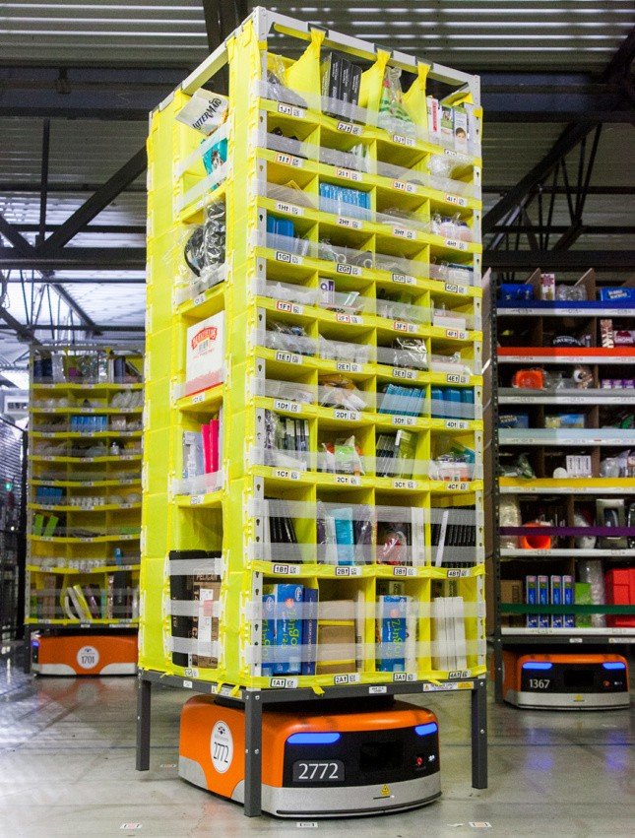
RECOMMENDATION
Create robot prototypes and assess the progress
Produce the final item and distribute it to Nigeria's biggest Jumia warehouses.
Construct new warehouses for inventory replenishment, so Jumia may expand its network of fulfilment centres throughout Nigeria.
Fitting the most inventory inside their warehouse is one of Jumia's objectives. Jumia has introduced inventory storage pods, which are arranged in clusters with one-way routes between them. Jumia's storage space utilization is probably over 65% thanks to the use of these robots (assuming some shuffling space but omitting the traffic area toward picking). Compared to their manual storage alternatives, this is considerably superior.
People, especially warehouse workers, should receive new technical skills training.

Slide 14

REFERENCES
Acharya, B. (2022, August 10). African e-commerce firm Jumia says it is past peak losses, shares jump. Reuters. https://www.reuters.com/technology/african-e-commerce-firm-jumia- says-it-is-past-peak-losses-shares-jump-2022-08-10/
Byrne, J. (2018, April 24). Jumia Nigeria from Retail to Marketplace B SWOT Analysis. Case48. https://www.case48.com/swot-case/23235-Jumia- Nigeria-from-Retail-to-Marketplace-B
Impact Of Advanced Technology in the Growth of E-Commerce Sector In The Indian Market In Recent Years. (n.d.). Indian Retailer. Retrieved December 30, 2022, from https://www.indianretailer.com/article/technology/digital- trends/impact-of-advanced-technology-in-the-growth-of-e-commerce- sector-in-the-indian-market-in-recent-years.a7669
Jumia. (n.d.). About Jumia Group | Get to know more about us. Jumia Group. https://group.jumia.com/about
MasterClass. (2022, June 1). Market Culture: Pros and Cons of Market Culture. https://www.masterclass.com/articles/market-culture

